Slide 1
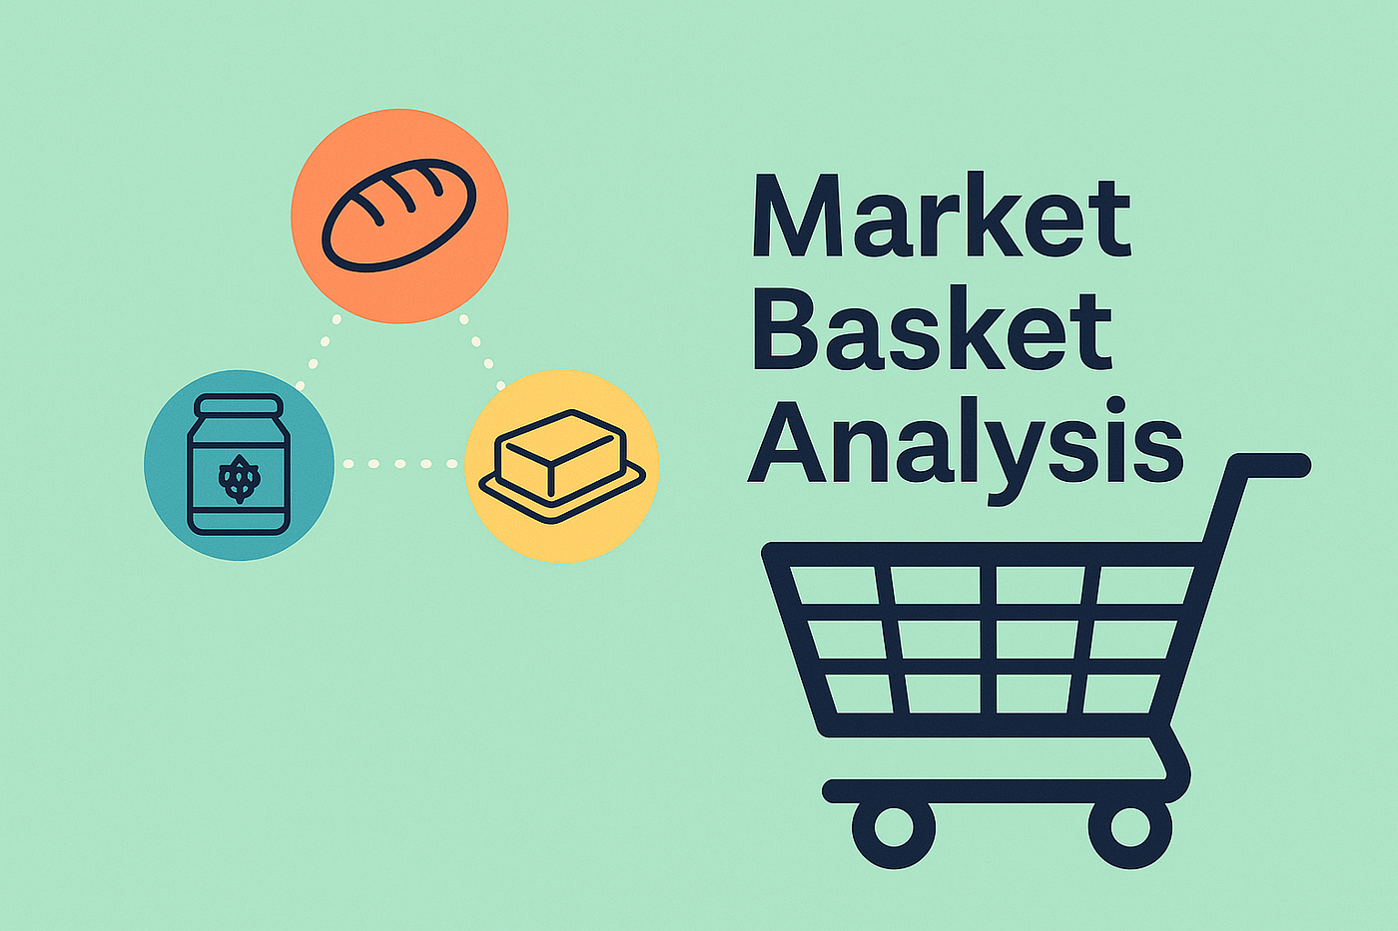
Purchase Pattern Analysis Using Apriori Algorithm Market Basket Analysis for Combo Offer Optimisation
CLIENT PROJECT
TOOLS: MYSQL, PYTHON, APRIORI ALGORITHM , POWER BI, ADVANCE EXCEL
TEAM ID : PTID-CDA-JAN-26-1134
PROJECT ID : CDACL005 - PURCHASE PATTERN ANALYTICS
ANALYST: SRASHTI DUBEY
EMAIL: SRASHTIDUBEY73@GMAIL.COM

Slide 2
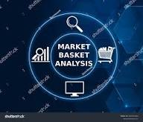
Project Overview
Purchase Pattern Analysis Using Apriori Algorithm
The Purchase Pattern Analytics project focuses on analyzing retail transaction data to understand customer buying behavior, transaction patterns, and product demand. The project follows an end-to-end analytics lifecycle involving data ingestion, cleaning, validation, exploratory analysis, outlier detection, transaction transformation, and finally Market Basket Analysis using the Apriori algorithm. Multiple tools were used across different stages of the project MySQL, Excel, Power BI, and Python (Jupyter Notebook) to ensure strong data quality, analytical accuracy, and business ready insights.

Slide 3
Problem Statement
Business challenge:-
Retail businesses often lack clear visibility into which products are frequently purchased together, making it difficult to design effective product bundles, cross-selling strategies, and targeted promotions based on actual customer behavior.
Analytical need:-
To make informed decisions, retailers require data-driven insights derived from transactional data that go beyond intuition. Understanding purchase associations is critical to improve sales performance, customer experience, and revenue optimization.
Opportunity through analytics:-
Using market basket analysis (MBA) with EDA, data cleaning, visualization, and the apriori algorithm, hidden product relationships are identified. This enables frequently co-purchased product detection, effective bundling & placement, and personalized recommendations to improve customer satisfaction.

Slide 4
Understanding Customer Buying Behaviour
KEY FOCUS
Identifying Product Associations using Market Basket Analysis
Improving Data Quality for Reliable Insights
Deriving Actionable Business Insights
Visualizing Insights for Decision-Making
Time-Based Trend Analysis

Slide 5
Transactional Dataset Overview
About the dataset This dataset contains detailed transactional purchase records capturing customer buying behavior across multiple products and time periods. It is structured to support purchase pattern analysis, trend identification, and association rule mining.
Key Attributes :-
Transaction ID -Unique Identifier For Each Customer Purchase
Product Name -Item Purchased, Used For Basket And Association Analysis
Quantity - Number Of Units Purchased Per Transaction
Transaction Date Enables Time-based And Trend Analysis
Price-item Level Pricing Used To Calculate Revenue
Customer ID - Identifies Individual Customers For Behavior Tracking
Country-Customer Location For Geographic Performance Analysis
Business Value:-
* Enables Market Basket Analysis (MBA) To Uncover Product Associations
* Supports Country-wise Sales And Demand Analysis
* Helps Analyze Customer-level Purchasing Patterns
* Provides Insights For Cross-selling, Bundling, And Revenue Optimization

Slide 6

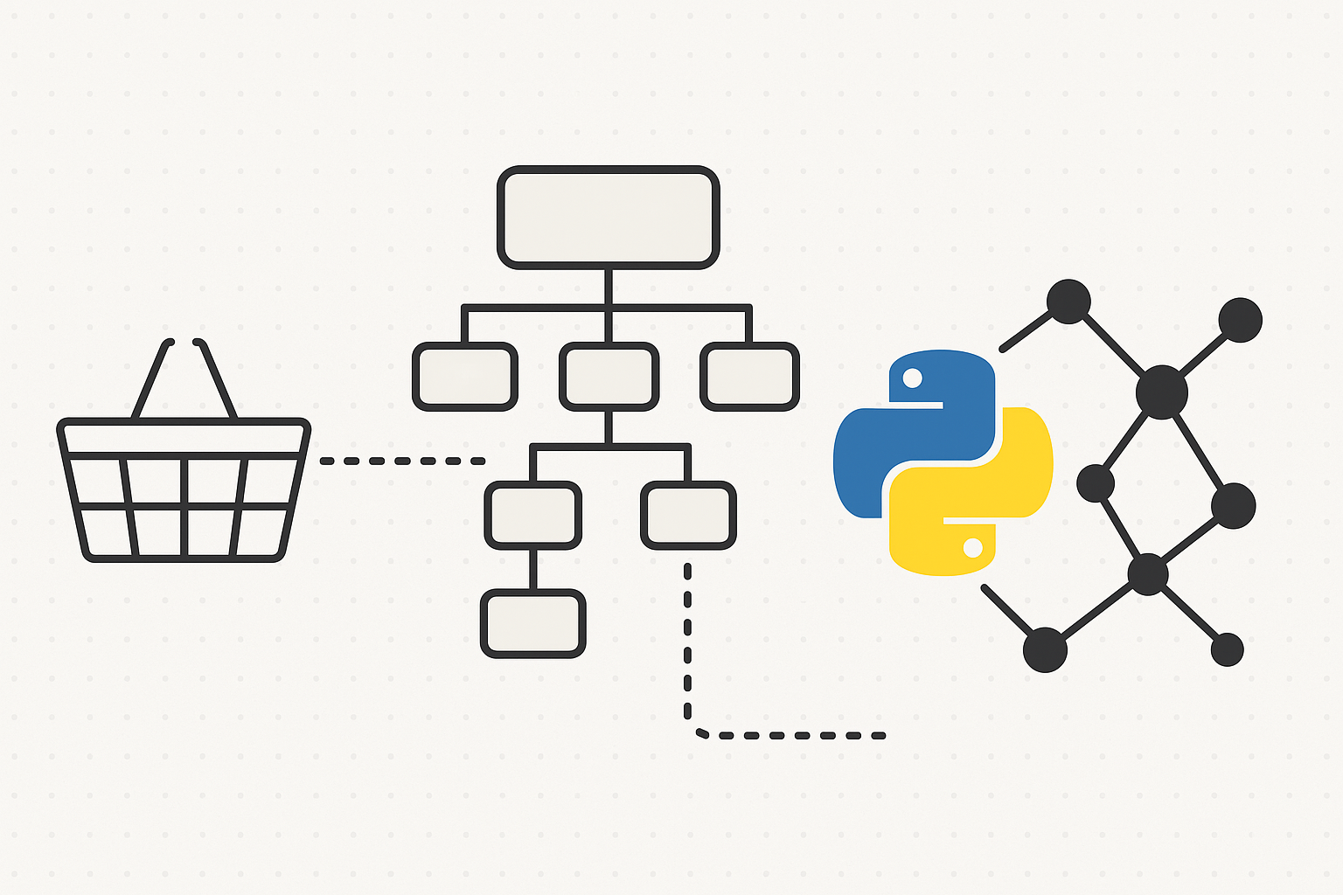


Tools & Technologies Used
1.MYSQL:-
DATA IMPORT & STORAGE
SQL-BASED EDA AND DATA VALIDATION
TRANSACTION DATA TRANSFORMED INTO INVOICE–ITEM FORMAT
3. PYTHON (APRIORI ALGORITHM):-
MARKET BASKET ANALYSIS PERFORMED
FREQUENT ITEMSETS & ASSOCIATION RULES GENERATED
STRONG RULES FILTERED USING SUPPORT, CONFIDENCE & LIFT
2. ADVANCED EXCEL:-
MISSING VALUE & DUPLICATE CHECKS
INVOICE-LEVEL OUTLIER DETECTION (IQR METHOD)
PIVOT TABLES & VALIDATION ANALYSIS
4. POWER BI:-
INTERACTIVE DASHBOARDS CREATED
SALES ANALYSIS WITH & WITHOUT OUTLIERS
BUSINESS INSIGHTS VISUALIZED FOR STAKEHOLDERS

Slide 7
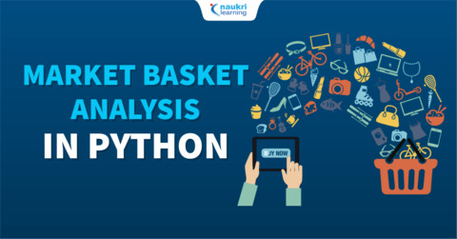
Data Preparation Workflow
EXPORT TO
EXCEL/CSV
DATA COLLECTION & STORAGE (MYSQL)
DATA CLEANING & PREPARATION (SQL + EXCEL)
VISUALIZATION WITH APRIORI ALGORITHM
(PYTHON)
APRIORI ALGORITHM
(PYTHON)
PATTERN ANALYSIS (PYTHON)
VISUALIZATION & INSIGHTS (POWER BI)

Slide 8
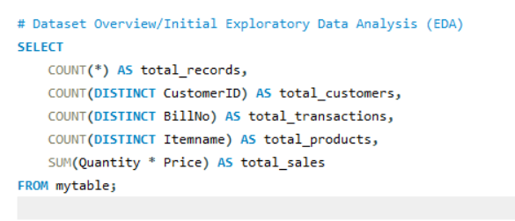
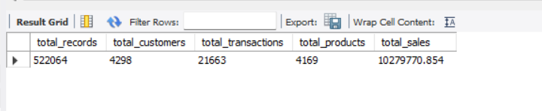
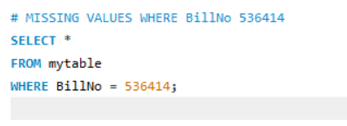
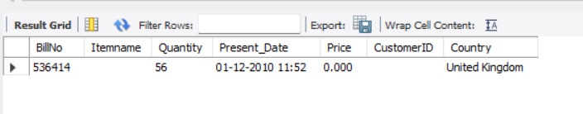
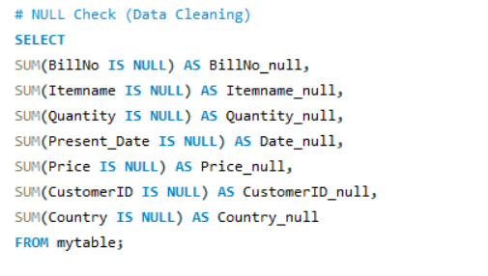
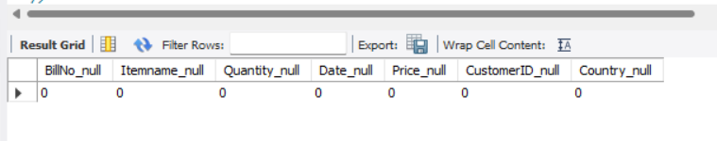
Exploratory Data Analysis (EDA)

Slide 9
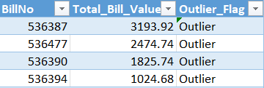
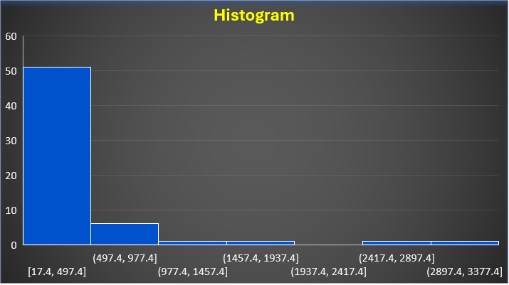
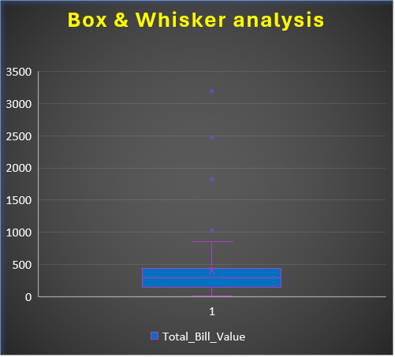
Outlier Analysis (Invoice-level)
Identified 4 high-value invoices using IQR method
Outliers represent bulk/corporate buyers
Removing outliers reduced AOV from 405 → 378
Retail behavior becomes more stable and realistic
These outliers represent bulk or corporate buyers with disproportionate revenue contribution.

Slide 10
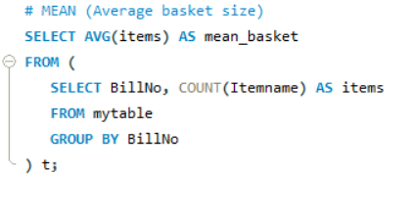
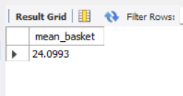
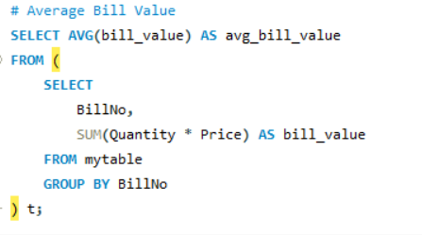
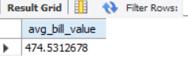
KEY STATISTICS (Mean / Median / Mode)
The average customer basket contains 24 items with an average bill value of 475, indicating high-volume purchases and strong bundling potential per transaction.

Slide 11
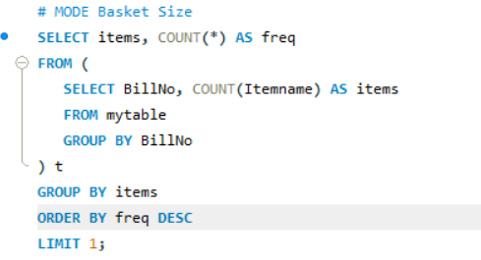
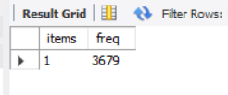
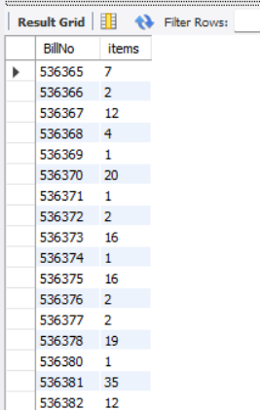
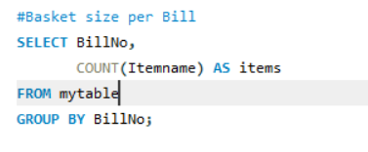
KEY STATISTICS (Mean / Median / Mode)
The most common basket size is 1 item, indicating a high frequency of single-item purchases alongside fewer but significantly larger multi-item transactions.

Slide 12
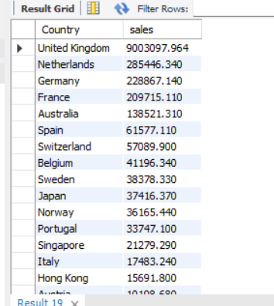
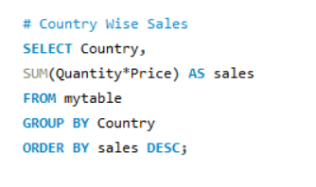
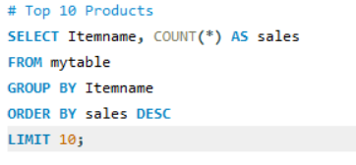
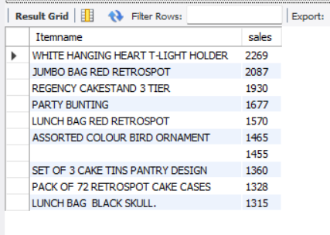
Business-level Insights (SQL)

Slide 13
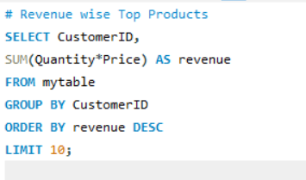
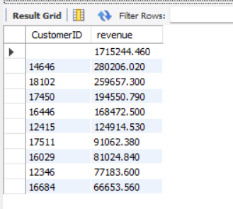
Business-level Insights (SQL)
Key Findings From SQL Analysis:-
Mean Basket Size: -24.10 Products Mode Basket Size:- 1 Product (3,679 Transactions)
Average Bill Value: -474.53
Key Findings From SQL Analysis:-
Total Records Analyzed:- 522,064
Unique Customers: -4,298
Total Transactions:- 21,663
Total Sales: -10.28m
UK Contribution: -94% Of Revenue

Slide 14
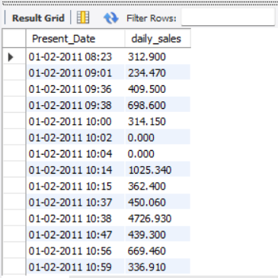
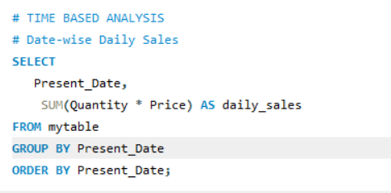
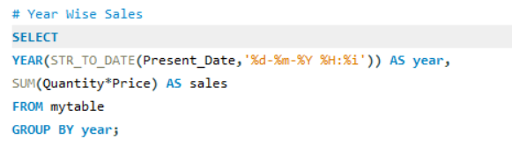
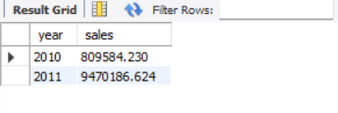
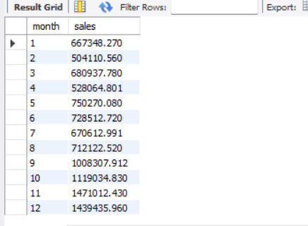
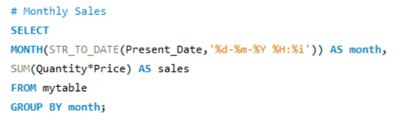
Time-based Trend Analysis
2010 Sales: -809K ,2011 Sales: -9.47M ,Peak months: - Sep–Oct , UK dominates sales

Slide 15
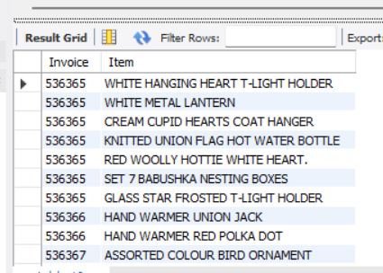
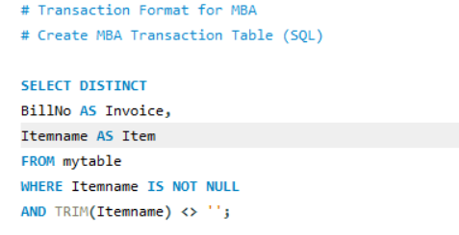
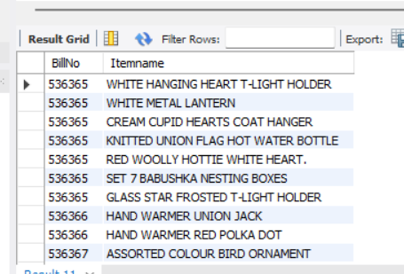
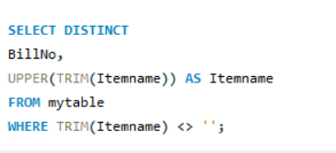
Transaction Format For MBA Create MBA Transaction Table (SQL)

Slide 16
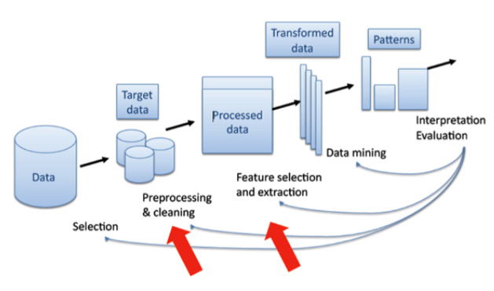
Data Cleaning & Preparation
1.Data Quality Assessment :-
Identified And Handled Missing Values, Duplicates, And Inconsistencies Using Mysql Queries To Ensure Dataset Integrity.
2. Transaction Transformation:-
* Restructured Data At Transaction Level, Grouping Products By Purchase Event To Create The Required Format For Basket Analysis.
3.Mining Preparation:-
Converted Transactional Records Into A Binary Matrix Format Suitable For Apriori Algorithm Processing And Rule Generation.

Slide 17
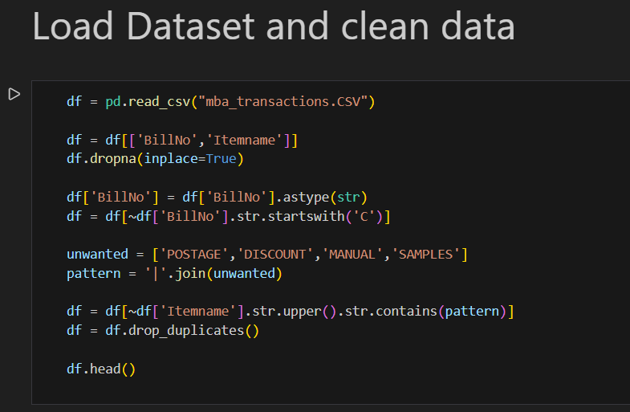
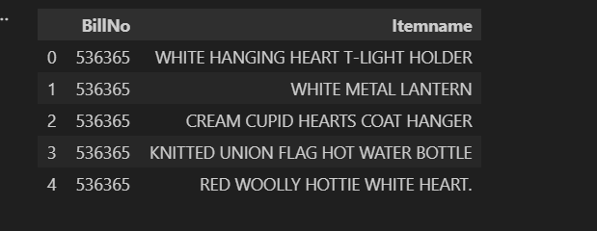
Data Understanding & Preparation

Slide 18
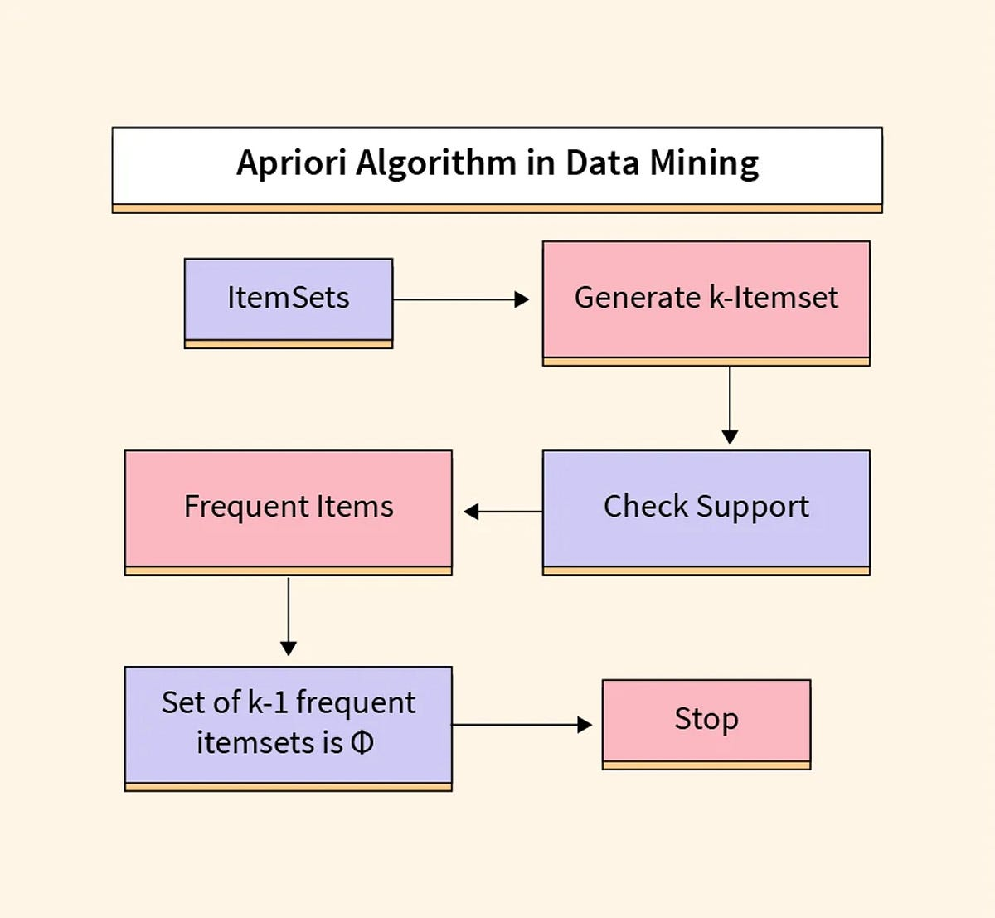
Methodology 3 - Apriori Algorithm
1. Frequent Itemsets:-
Generated Frequent Itemsets To Identify Commonly Purchased Products
2. Support Metric:-
Applied Support Threshold To Filter Meaningful Combinations
3.Confidence & Lift :-
Evaluated Rule Strength Using Confidence And Lift Metrics
4. Rule Filtering :-
Retained Strong, Actionable Rules For Business Insights

Slide 19
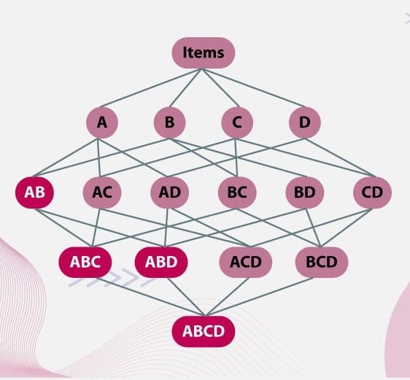
Purchase Pattern Insights
Frequent item combinations :-
Analysis revealed several high-frequency product pairings and triplets that consistently appear together in customer baskets
Top Pairs :-
Products Frequently Purchased As Complementary items With in single transaction
Strong Rules:-
Association Rules With High Confidence And Lift Values Indicating Genuine Purchasing Patterns
Cross-category :-
Unexpected Combinations Spanning Different Product Categories Revealing Customer Behavior

Slide 20
Market Basket Analysis Dashboard - Key Purchase Patterns
Support Analysis:-
Bar charts displaying frequent Itemsets and support values, highlighting commonly co-purchased products.
Association Network:-
Rule-based visualisations illustrating product relationships derived from confidence and lift metrics.
Lift Metrics :-
Sorted visualisations prioritising high-lift, high-confidence rules with strong business impact.
All visualisations are derived directly from Apriori algorithm outputs for clear, actionable interpretation.

Slide 21
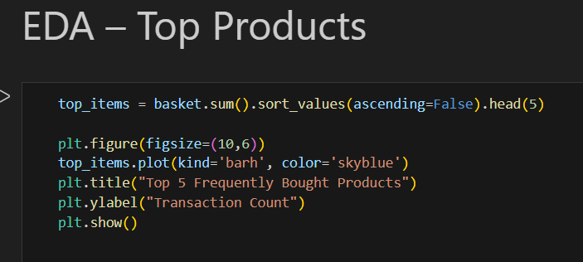
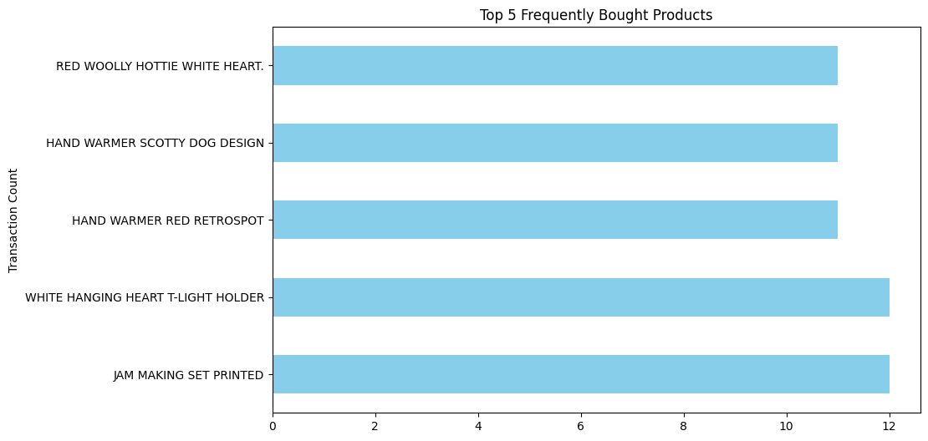
Exploratory Data Analysis USING PYTHON (EDA)
Analyzed product frequency and transaction behavior
Identified high-demand products and purchase trends
Established baseline insights before Apriori modeling

Slide 22
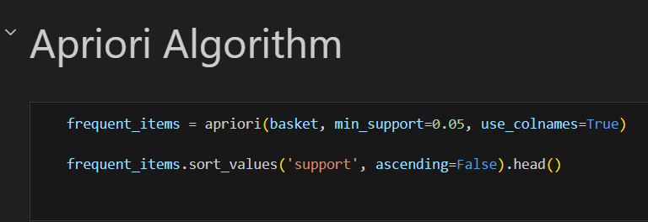
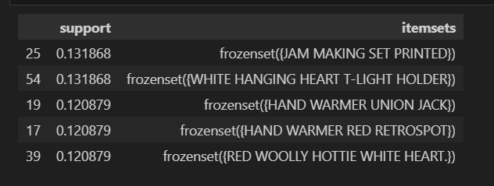
Apriori Algorithm - Frequent Itemsets
The frequent Itemsets show that utility and seasonal products (hand warmers, hot water bottles, decor items) are repeatedly purchased on their own, indicating strong standalone demand that later drives high-confidence bundle and cross-sell opportunities.

Slide 23
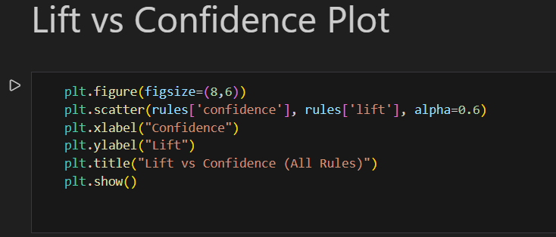
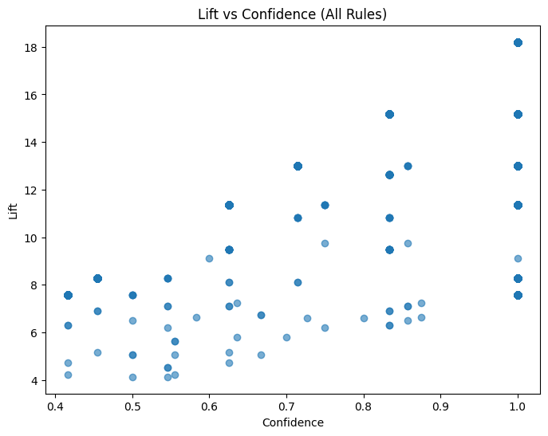
Association Rules Evaluation
Identifies strong and reliable product associations by highlighting rules that outperform random co-purchase behavior.

Slide 24
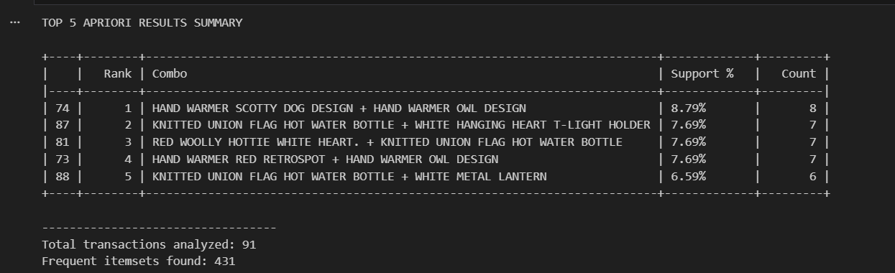
Top 5 Apriori Results Summary

Slide 25
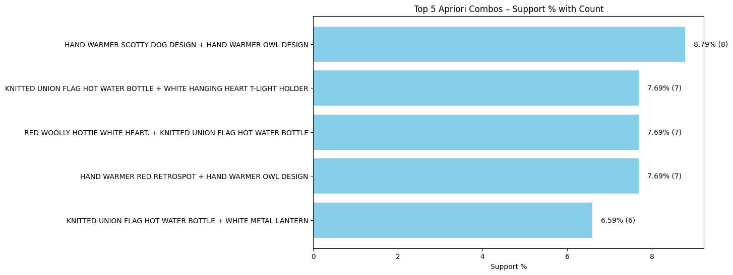
Visualization Of Top Combos
The bundle Hand Warmer Scotty Dog Design + Hand Warmer Owl Design is the highest-performing combo with 8.79% support (8 transactions), while the remaining top bundles show consistent demand at 6.59%–7.69%, indicating stable cross-sell potential rather than reliance on a single dominant bundle.

Slide 26

Pie Chart -Top 5 Combo Support
The top 5 bundles show a balanced support distribution (17%–23%), indicating multiple equally popular product combinations.

Slide 27


Business Impact

Slide 28
Business Impact
Business Impact:-
• Average Lift: 10.67x
• Confidence Rate: 84.16%
• Actionable Rules: 84
Strategic Applications: -
1.Combo Offers -Bundle High-lift Product Pairs With Discount For Promotions.
2. Cross Selling - Recommend Consequent Items With High Confidence Just Like Amazon :-“Frequently Bought Together.
3. Revenue Optimisation - Focus Marketing On Top Frequent Combos.
4.High Lift Values Indicate Strong Positive Relationships Between. Associated Products, While High Confidence Ensures Prediction Reliability.

Slide 29
Actionable Insights:-
1. Customers frequently purchase certain product combinations together, Indicating opportunities for bundled offerings.
2. High confidence rules suggest strong predictability in customer buying behavior.
3. Strong lift values highlight effective cross-selling
potential between related products.
4. These patterns can be used to improve store layout, promotions,
And recommendation strategies.
Business Recommendations:-
1.Combo Offers:- Use Top Product Combinations Identified By Apriori To Create Data-driven Bundle Offers.
2. Cross-selling Strategy:-recommend Associated Products During Checkout And Online Shopping.
3. Shelf Placement Optimization:-place Frequently Co-occurring Products Closer To Increase Impulse Buying.
4. Targeted Promotions:-run Promotions On Products Involved In High-lift Association Rules.

Slide 30

Sales & Purchase Pattern Insights Dashboard

Slide 31

Sales Performance Overview Dashboard

Slide 32
Final Insights
Using the apriori algorithm, frequent Itemsets and association rules were generated to identify strong product relationships. By applying strict thresholds for support, confidence, and lift, the analysis produced 84 strong and actionable association rules with high reliability and business relevance.
Strong purchase patterns identified:- Apriori analysis revealed frequently co-purchased product combinations, highlighting clear complementary buying behavior across transactions.
Actionable association rules:- Rules filtered using support, confidence, and lift ensured only high-impact and statistically significant product relationships were retained.
Cross-category opportunities:- Several cross-category associations were observed, indicating opportunities for bundling and cross-selling beyond single product categories.
Market concentration insight:- Sales analysis showed uk contributes ~94% of total revenue, indicating strong market dependence and a clear priority region.
Impact of outliers on performance metrics:- Removing outliers stabilized revenue (24.7k → 23.1K) and AOV (405 → 378), providing a more realistic view of core retail demand.
Time-based Trend Analysis:- 2010 Sales: -809K ,2011 Sales: -9.47M ,Peak months: - Sep–Oct , UK dominates sales

Slide 33
Conclusion
Delivered a complete retail analytics solution from raw transactions to business insights
Identified high-impact product associations using Apriori-based market basket analysis
Enabled data-driven bundling and cross-sell strategies aligned with customer behavior
Insights support measurable revenue uplift and improved customer experience

Slide 34


